Slide 1

Introduction to Microcontrollers Fall Term, 2021
Professor Allan Douglas

Slide 2
EE333 - Course Instructor
Associate Professor: Allan Douglas
Email: allan.douglas@oit.edu
BSEE Oregon State University 1991
MSEE Oregon State University 1993
28 years of industry experience
Digital System Design/Architecture
Field Programmable Gate Arrays (FPGA)
Microprocessors/Microcontrollers
VHDL/Verilog
High-Speed Circuit Boards

Slide 3
EE333 - Description and Prerequisites
Course Description
Microcontroller engineering using popular microcontroller, internal structures and control units, timing, interrupts, memory interfacing, assembly language programming specific to microcontroller, and on-chip peripheral devices.
Prerequisites CST 116
Corequisites CST 133 or EE 133 or EET 216

Slide 4
EE333 - Lab Work
Labs
The list of required components is available on Canvas.
There will be 8 labs this term.
Labs may provide opportunities for students to earn extra credit. Extra credit will be work 5%. If students desire to go further with lab work, they may gain more than 5% extra credit with instructor approval.
Students will work independently.
Students will have one week to complete each lab.
Each student will submit a Lab Report.
Late Lab Reports will be penalized 5% per day late.
Lab Reports submitted more than 7 days after the due date will not be accepted.
Extra Credit Lab
At the end of the term, we may have time for an extra credit lab.
Please talk to the instructor if you are interested.

Slide 5
EE333 - Grading
Homework and Exams
This course does not have homework assignments or exams. Instead, the course consists of extensive hands-on, lab work.
Grading
Lab Reports 100% (each is worth 12.5%)

Slide 6
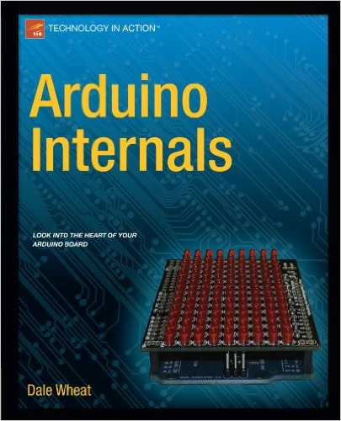

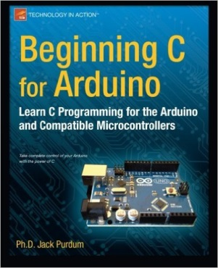
EE333 – Textbook(s)
Arduino Internals (Recommended)
Dale Wheat
ISBN: 978-1-430-23882-9
Exploring Arduino (Optional)
Jeremy Blum, 2013
ISBN: 978-1-118-54936-0
Beginning C for Arduino (Optional)
Jack Purdum, 2012
ISBN: 978-1-430-24776-0
Most material is available online.

Slide 7
EE333 - Schedule
Week 1 - Class Syllabus/Intro to Microcontrollers/Software Tools
Week 2 - Intro to Microcontroller Programming and Tools
Week 3 - Serial Communication
Week 4 - Microcontroller Internal Structure
Week 5 – Timer/Counters & Interrupts
Week 6 – Pulse Width Modulation
Week 7 – A/D Converters and Comparators
Week 8 – Wireless Communications
Week 9 - Programming in C & Assembly
Week 10&11 – Special Topics

Slide 8
EE333 - Lab Assignments
Lab#1: Building and Executing Code on a Microcontroller
Breadboard prototype, Arduino IDE/Sketches, Blink, Loading Code
Lab#2: Serial Communications
USB, RS-232, SPI, I²C
Lab#3: Digital Clock
Liquid Crystal Displays and Real-Time Clocks with I²C
Lab#4: Timers, Counters & Interrupts
Measuring and generating digital waveforms
Lab#5: Pulse Width Modulation
PWM of LEDs, PWM drive of DC Motors, Stepper Motors, Servos
Lab#6: A/D Conversion and Comparators
Temperature and signal measurement
Lab#7: Wireless Communications
Infrared (IR) and Radio Frequency (RF) Communications
Lab#8: Assembly Programming

Slide 9
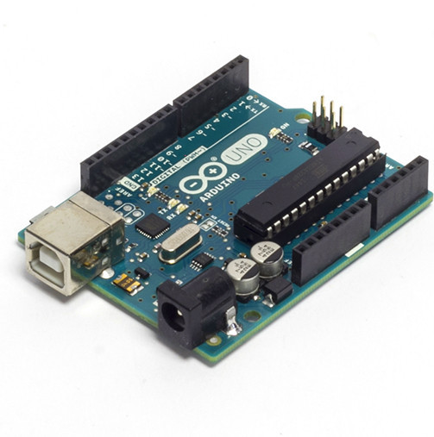
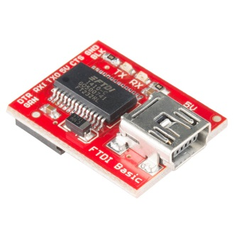
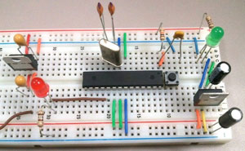
EE333 - Lab Materials
Qty | Required | Vendor | PN | Cost
1 | Build Your Own Arduino Kit | Jameco | 2151259 | $ 14.95
1 | Arduino Uno | Arduino | UNO Rev3 | $ 24.95
1 | FTDI Basic Breakout - 5V | Sparkfun | DEV-09716 | $ 14.95
1 | IC I/O EXPANDER I2C 8B 18DIP | Digikey | MCP23008-E/P-ND | $ 1.22
1 | IC I/O EXPANDER SPI 8B 18DIP | Digikey | MCP23S08-E/P-ND | $ 1.28
1 | Basic 16x2 Character LCD - Black on Green 5V | Sparkfun | LCD-00255 | $ 13.95
1 | 10K Ohm Potentiometer | Digikey | CT6EP103-ND | $ 0.79
1 | Real Time Clock | Digikey | DS1307+-ND | $ 3.37
1 | Crystal (32.768kHz Quartz Crystal) | Digikey | 535-9034-ND | $ 0.17
1 | DC Motor | Sparkfun | ROB-11696 | $ 1.95
1 | Diode Small Signal - 1N4148 | Sparkfun | COM-08588 | $ 0.15
1 | Transistor - NPN (BC337) | Sparkfun | COM-13689 | $ 0.50
1 | Temperature Sensor - TMP36 | Sparkfun | SEN-10988 | $ 1.50
1 | LED - Infrared 950nm | Sparkfun | COM-09349 | $ 0.95
1 | IR Receiver Diode - TSOP38238 | Sparkfun | SEN-10266 | $ 1.95
1 | WiFi Module - ESP8266 | Sparkfun | WRL-13678 | $ 6.95
1 | Logic Level Converter - Bi-Directional | Sparkfun | BOB-12009 | $ 2.95
 | Total |  |  | $ 92.53
You will also need a breadboard, jumper wires, and various resistors/caps.

Slide 10
EE333 - Software
Required
Arduino 1.8.10 Integrated Development Environment (IDE)
Arduino sketch development, serial comms, and download
https://www.arduino.cc/en/Main/Software
Optional
Atmel Studio 7.0 IDE (optional)
Complete IDE for all Amtel products
https://www.microchip.com/mplab/avr-support/atmel-studio-7
WinAVR 2010_01_10 (optional)
C compiler, linker, file conversion, programming tools
http://sourceforge.net/projects/winavr/files/

Slide 11
Lecture Outline
Introduction to Microcontrollers
Types and Manufactures of Microcontrollers
Introduction to the Amtel Atmega 328P Microcontroller
Arduino Boards
Software Tools (Arduino IDE)
Libraries
Example Code (Sketches)
Introduction to Lab#1
Objectives and Checklist
DIP 28 Pinout and Pin Descriptions
Atmega 328P Datasheet/Features
Lab#1

Slide 12
Introduction to Microcontrollers
What is a Microcontroller?
A microcontroller (sometimes abbreviated µC, uC or MCU) is a small computer on a single integrated circuit containing a processor core, memory, and programmable input/output peripherals.
Built-in functions/peripherals usually included are:
Volitile Memory (SRAM)
Non-Volitile Memory (Flash, EEPROM)
Clock Generators
General purpose Inout/Outputs (GPIO)
Data Converters (ADCs and DACs)
Timers, Event Counters, and Pulse Width Modulation (PWM) blocks
Serial Input/Output ports (UARTs)
Serial Interfaces (SPI, I2C, USB, CAN)
Other Interfaces (SD card readers, Ethernet, etc.)
How is it different from a Microprocessor?
Microcontrollers are designed for embedded applications, in contrast to the microprocessors used in personal computers or other general purpose applications.
https://en.wikipedia.org/wiki/Microcontroller

Slide 13
What are common Microcontrollers?
As of 2008, there are several dozen microcontroller architectures and vendors including:
ARM core processors (many vendors)
ARM Cortex-M cores are specifically targeted towards microcontroller applications
Atmel AVR (8-bit), AVR32 (32-bit), and AT91SAM (32-bit)
Cypress Semiconductor's M8C Core used in their PSoC (Programmable System-on-Chip)
Freescale ColdFire (32-bit) and S08 (8-bit)
Freescale 68HC11 (8-bit)
Intel 8051
Infineon: 8-bit XC800, 16-bit XE166, 32-bit XMC4000 (ARM based Cortex M4F), 32-bit TriCore and, 32-bit Aurix Tricore Bit microcontrollers^{[18]}
MIPS
Microchip Technology PIC, (8-bit PIC16, PIC18, 16-bit dsPIC33 / PIC24), (32-bit PIC32)
NXP Semiconductors LPC1000, LPC2000, LPC3000, LPC4000 (32-bit), LPC900, LPC700 (8-bit)
Parallax Propeller
PowerPC ISE
Rabbit 2000 (8-bit)
Renesas Electronics: RL78 16-bit MCU; RX 32-bit MCU; SuperH; V850 32-bit MCU; H8; R8C 16-bit MCU
Silicon Laboratories Pipelined 8-bit 8051 Microcontrollers and mixed-signal ARM-based 32-bit microcontrollers
STMicroelectronics STM8 (8-bit), ST10 (16-bit) and STM32 (32-bit)
Texas Instruments TI MSP430 (16-bit) C2000 (32-bit)
Toshiba TLCS-870 (8-bit/16-bit)
https://en.wikipedia.org/wiki/Microcontroller

Slide 14
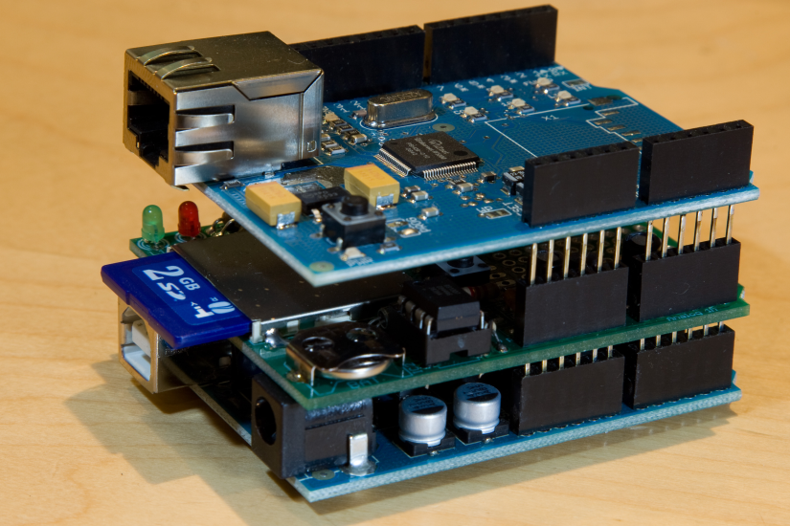
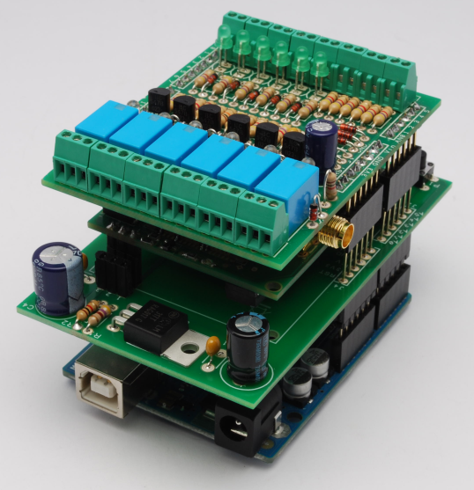
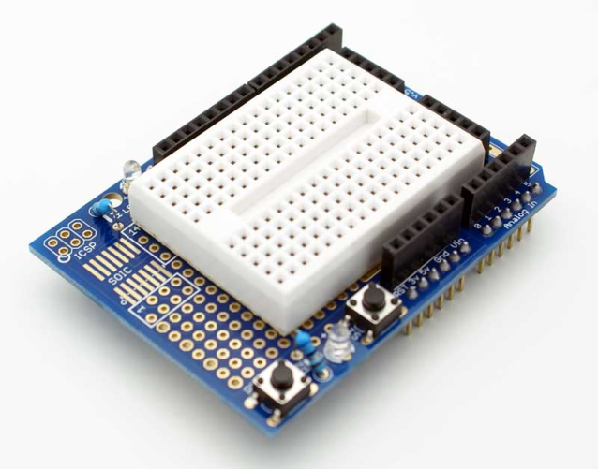
Why Arduino for EE333?
An “Arduino” is a specific 8-bit AVR microcontroller implementation with a flash installed bootloader, the Arduino IDE and a collection of software libraries. Programs can be downloaded over USB.
Enables us to use Arduino Sketches for code development rather than C or assembly language. Remember, the pre-requisites for EE333?
Establishes a standard hardware platform for connecting peripherals and “shields”.
Hardware is cheap, software is free, a special programmer is not required, and there is a massive amount of online documentation.

Slide 15
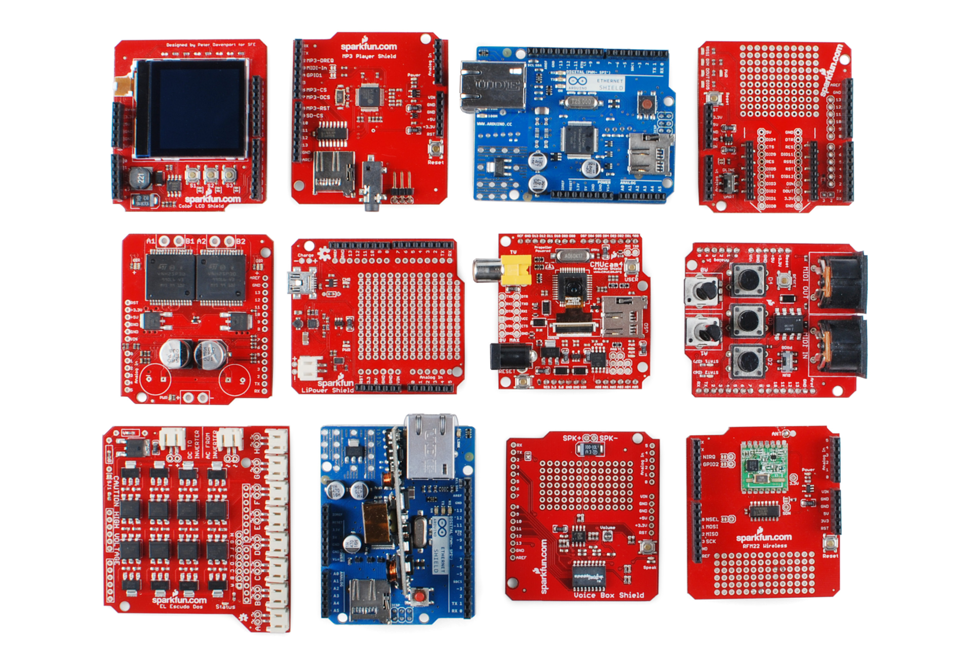
There are 100’s of shields available!

Slide 16
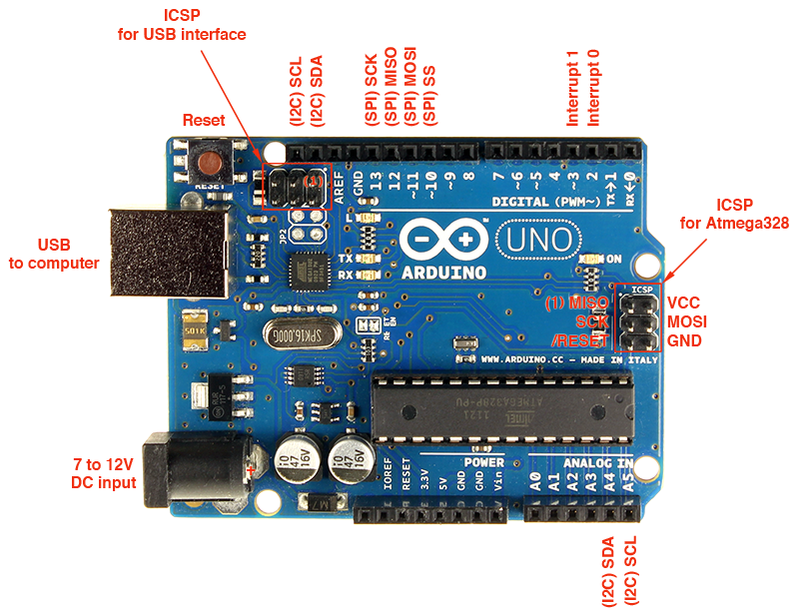
Arduino UNO
Serial port
Atmel ATmega328P
microcontroller
USB-to-Serial Chip

Slide 17
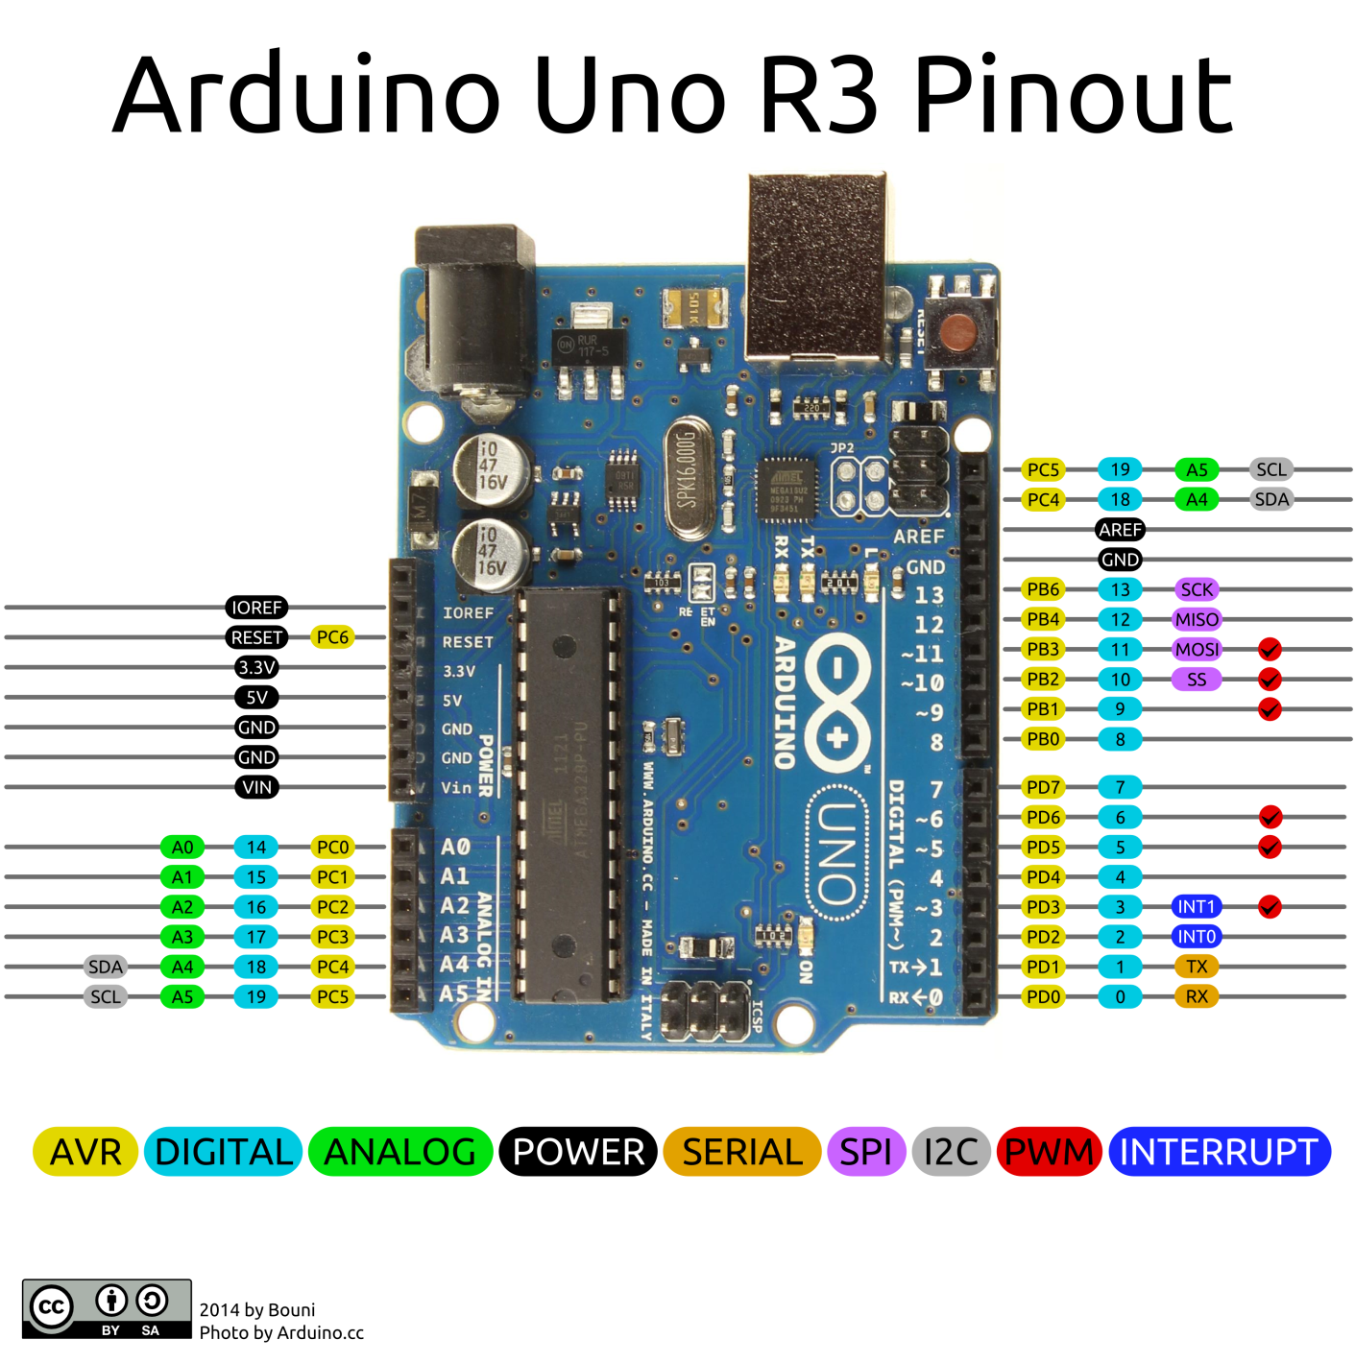
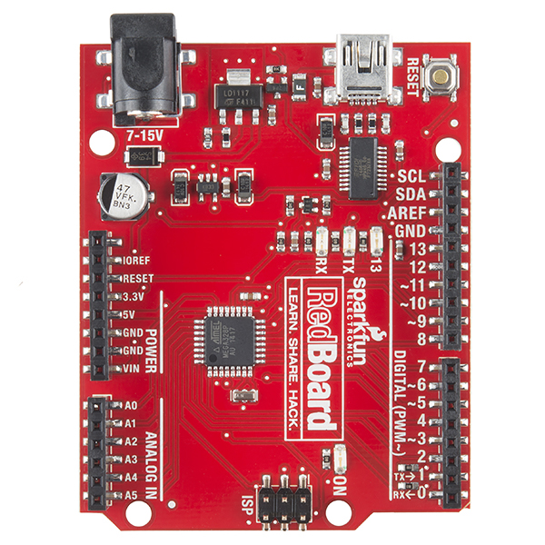
Arduino Uno R3/SparkFun RedBoard Pinouts
Std USB
Micro USB
SMT Package
DIP Package

Slide 18
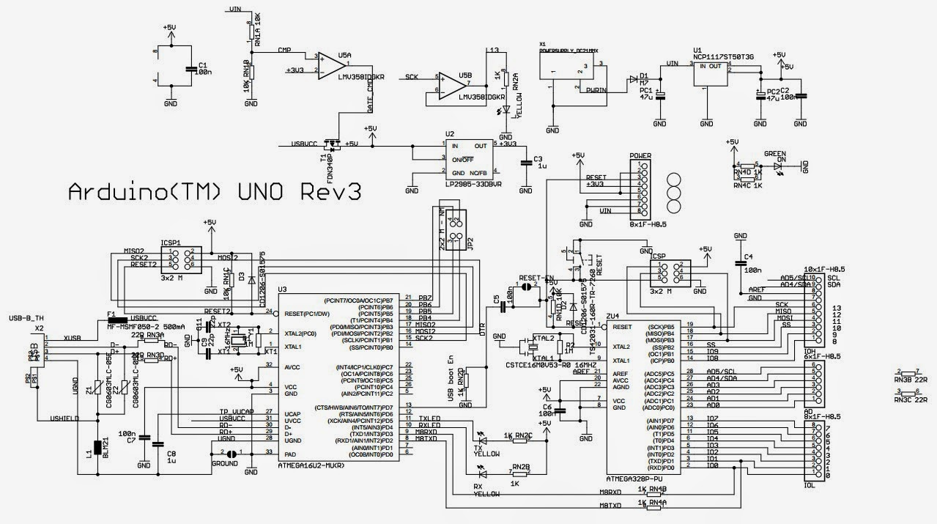
Arduino UNO Rev3 Schematic
Power Connector
5V Regulator
3.3V Regulator
Power LED
ICSP Connector
Reset Button
ICSP Connector
USBConnector
16MHz
16MHz
GPIO
Serial Comms LEDs
MicroController
Serial Comms
Converts USB to RS-232 Serial
MicroController
General Purpose Programming

Slide 19
ATmega328P 28-pin DIP Pinout

Slide 20
Atmel AVR Atmega 328P Microcontroller
High Performance, Low Power Atmel®AVR® 8-Bit Microcontroller Family
Advanced RISC Architecture
131 Powerful Instructions – Most Single Clock Cycle Execution
32 x 8 General Purpose Working Registers
Fully Static Operation
Up to 20 MIPS Throughput at 20MHz
On-chip 2-cycle Multiplier
High Endurance Non-volatile Memory Segments
4/8/16/32KBytes of In-System Self-Programmable Flash program memory
256/512/512/1KBytes EEPROM
512/1K/1K/2KBytes Internal SRAM
Write/Erase Cycles: 10,000 Flash/100,000 EEPROM
Data retention: 20 years at +85C/100 years at +25C
Optional Boot Code Section with Independent Lock Bits
In-System Programming by On-chip Boot Program
True Read-While-Write Operation
Programming Lock for Software Security
http://www.atmel.com/images/Atmel-8271-8-bit-AVR-Microcontroller-ATmega48A-48PA-88A-88PA-168A-168PA-328-328P_datasheet_Complete.pdf

Slide 21
Atmel AVR Atmega 328P Microcontroller
Peripheral Features
Two 8-bit Timer/Counters with Separate Prescaler and Compare Mode
One 16-bit Timer/Counter with Separate Prescaler, Compare, and Capture Mode
Real Time Counter with Separate Oscillator
Six PWM Channels
8-channel 10-bit ADC in TQFP and QFN/MLF package
6-channel 10-bit ADC in PDIP Package
Programmable Serial UART
Master/Slave SPI Serial Interface
Byte-oriented 2-wire Serial Interface (Philips I²C compatible)
Programmable Watchdog Timer with Separate On-chip Oscillator
On-chip Analog Comparator
Interrupt and Wake-up on Pin Change

Slide 22
Atmel AVR Atmega 328P Microcontroller
Special Microcontroller Features
Power-on Reset and Programmable Brown-out Detection
Internal Calibrated Oscillator
External and Internal Interrupt Sources
Six Sleep Modes: Idle, ADC Noise Reduction, Power-save, Power-down, Standby, and Extended Standby
I/O and Packages
23 Programmable I/O Lines
28-pin PDIP, 32-lead TQFP, 28-pad QFN/MLF and 32-pad QFN/MLF
Operating Voltage:
1.8V to 5.5V
Temperature Range:
-40C to +85C
Speed Grade:
0 - 4MHz@1.8 - 5.5V, 0 - 10MHz@2.7 - 5.5.V, 0 - 20MHz @ 4.5 - 5.5V
Power Consumption at 1MHz, 1.8V, 25C
Active Mode: 0.2mA
Power-down Mode: 0.1μA
Power-save Mode: 0.75μA (Including 32kHz RTC)

Slide 23
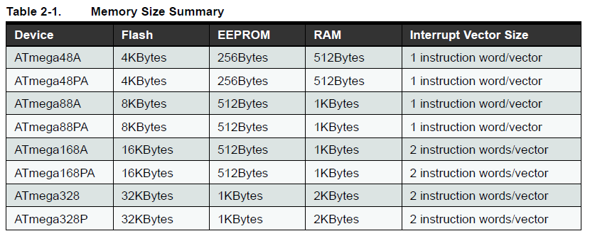
Different Atmega Microcontroller Memory Options

Slide 24
Block Diagram
Multi-purpose pins

Slide 25
Lab#1
The Lab Materials list has been posted on Canvas.
Lab#1 has been posted on Canvas.
Since you will need to order components, Lab#1 will be due at midnight on 10/19/21.
Your assignment for this week is to order the components so you can start working on the lab next week.
If you want to work at home or on a laptop, make sure your have the Arduino IDE installed.

Slide 26
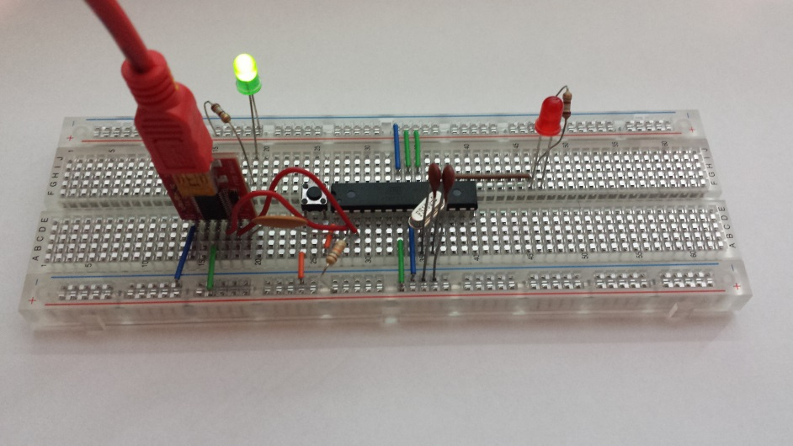
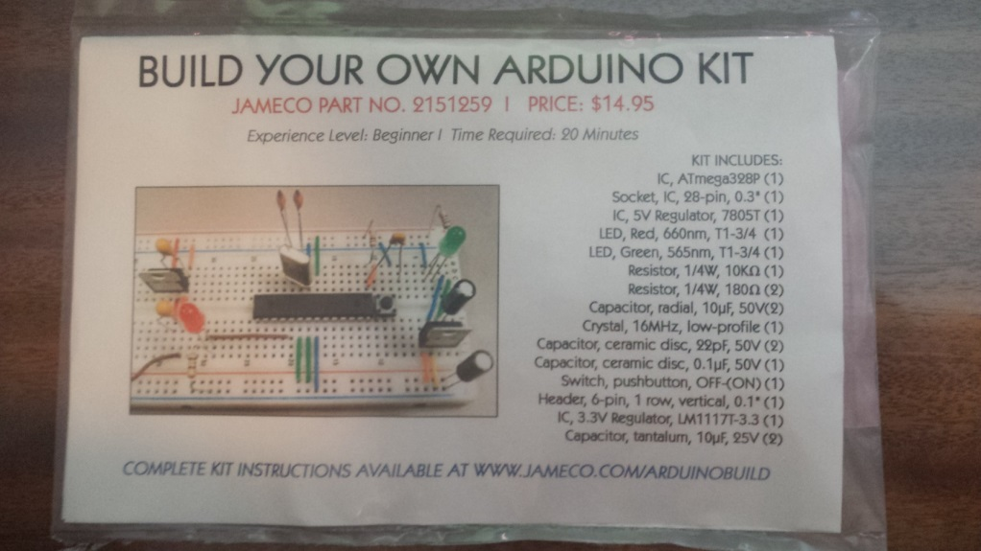
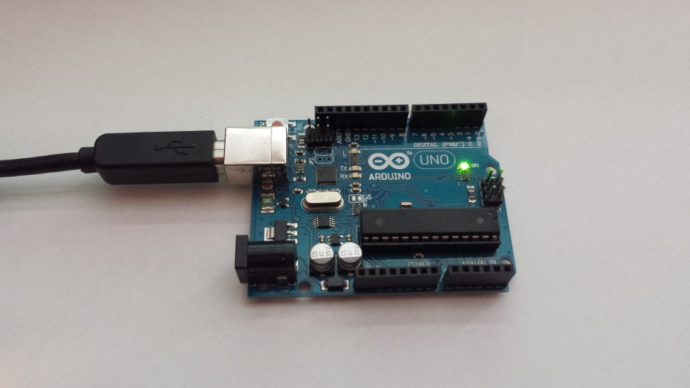
Lab#1
In this lab, the student will build an ATmega328P based microcontroller system on a breadboard, connect basic peripherals to allow the microcontroller to boot and execute basic Arduino sketches. Students will download software and confirm that the breadboard version of the microcontroller works exactly like the printed circuit board version of the ATmega328P included with the Arduino UNO or Spark Fun RedBoard.

Slide 27
Lab Reports
Each Lab is worth 12.5% of your overall grade.
Each Lab will be graded on a 100 point scale.
Make sure you answer every question stated in the Lab Descriptions and complete every time in the checklist included with the Lab.
All Lab Reports will be due at Midnight one week after they are assigned (Lab#1 and Lab#8 are the only exceptions).
Late Lab Reports will be penalized 5 points per day late.
All Labs should be submitted on Canvas. Please do not email your Lab Reports to the instructor.
Lab Reports should be submitted as a single PDF document with all software included as an appendix.

Slide 28
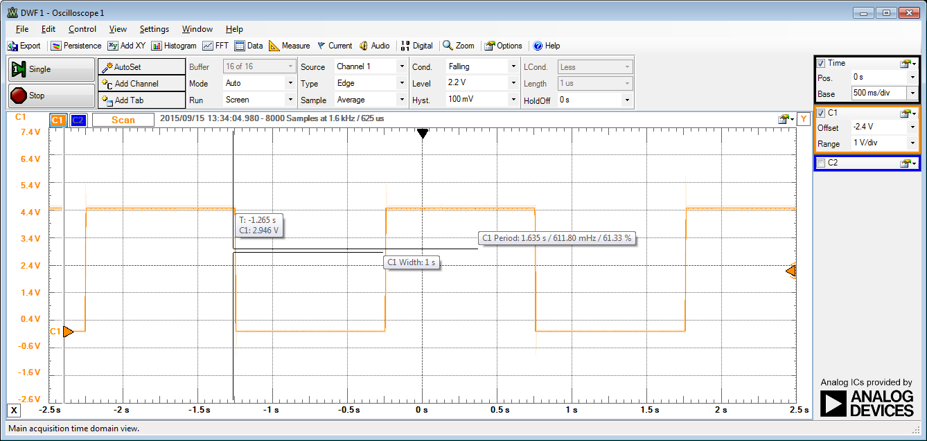
Lab Reports
Make sure to include oscilloscope and/or logic analyzer screenshots with your Lab Reports.
Add labels so that your writing can be clearly related to the waveforms.
Example

Slide 29
Next Week
Programming in Arudino "C"
Data Types and Variables
setup() and loop()
Programming Structures (conditional statements, loops, functions)
Bitwise operators, masking, shifting
Comments
Arduino Integrated Development Environment (IDE)
Compiling and downloading code
Arduino Libraries
Including Libraries
Example “Sketches”
Optiboot Bootloader
WinAVR Tools
avr-gcc, advdude

